Slide 1


Monetary Policy Committee
Monetary Policy Report August 2021
In focus – The outlook for inflation

Slide 2
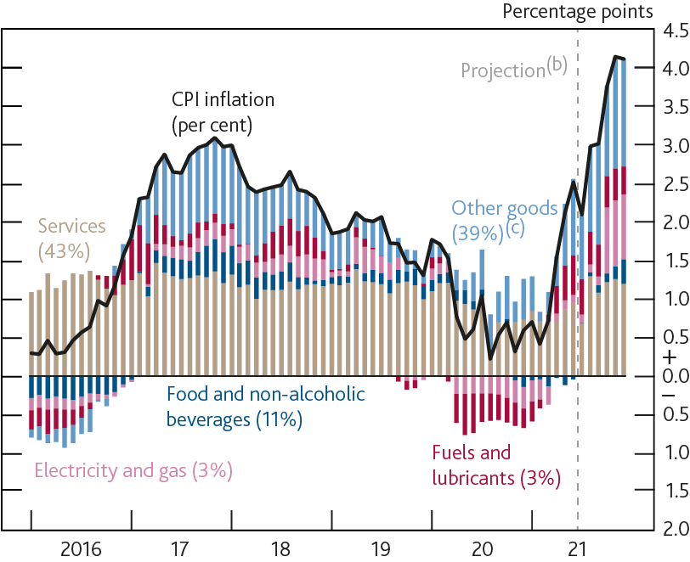
Chart 3.1: Inflation has picked up during 2021, and is expected to rise further in the near term
Contributions to CPI inflation^{(a)}
Sources: Bloomberg Finance L.P., Department for Business, Energy and Industrial Strategy, ONS and Bank calculations.
(a) Contributions to annual CPI inflation. Figures in parentheses are basket weights in 2021 and do not sum to 100 due to rounding.
(b) Bank staff’s projection. Fuels and lubricants estimates use Department for Business, Energy and Industrial Strategy petrol price data for July 2021 and then are based on the sterling oil futures curve.
(c) The difference between CPI inflation and the other contributions identified in the chart.

Slide 3
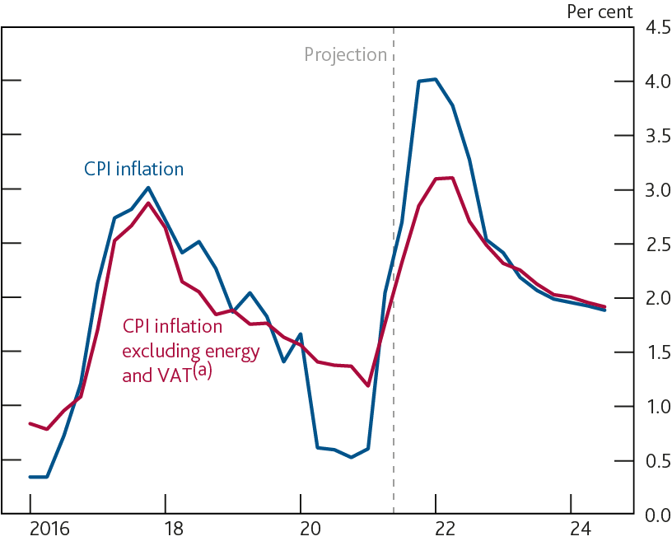
Chart 3.2: The MPC expects the near-term rise in inflation to be temporary
Quarterly CPI inflation including and excluding energy and VAT
Sources: ONS and Bank calculations.
(a) CPI inflation excluding fuels and lubricants, electricity, gas and other fuels. Data also adjusted to exclude estimates of the direct impact of changes in the rate of VAT. There is uncertainty around the precise size of that adjustment.

Slide 4
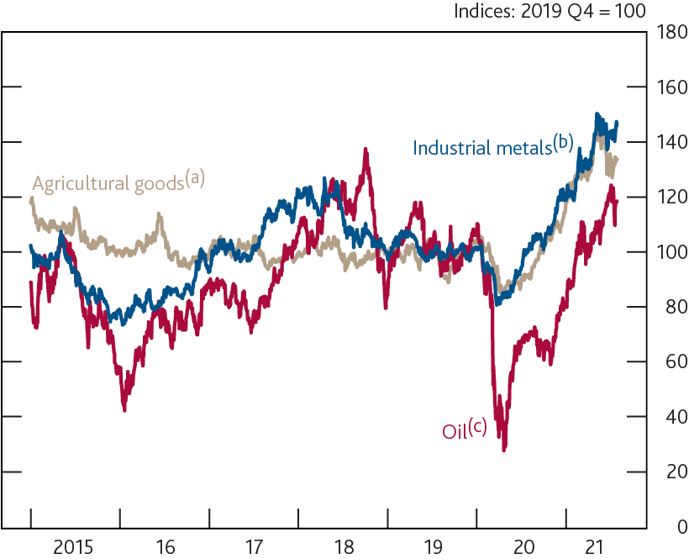
Chart 3.3: Oil and other commodity prices have risen sharply over the past year
US dollar commodity prices
Sources: Bloomberg Finance L.P., Refinitiv Eikon from LSEG, S&P Indices and Bank calculations.
(a) Based on the S&P Goldman Sachs Commodity Index Agricultural and Livestock Spot.
(b) Based on the S&P Goldman Sachs Commodity Index Industrial Metals Spot.
(c) Brent forward prices for delivery in 10–25 days’ time.

Slide 5
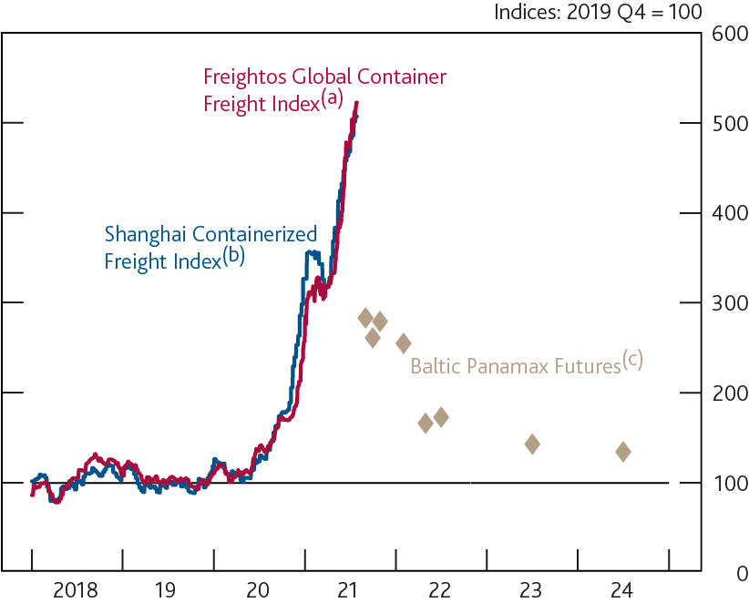
Chart 3.4: Shipping costs have risen sharply, but are expected to fall back
Shipping costs and forward freight agreement prices
Sources: Baltic Exchange, Freightos Baltic Index, Refinitiv Eikon from LSEG, Shanghai Shipping Exchange and Bank calculations.
(a) A measure of the cost of 40 foot container transport around the world.
(b) A measure of the cost of 20 foot container transport from China.
(c) Forward freight agreements indicating market expectations of future shipping costs on 28 July 2021.

Slide 6
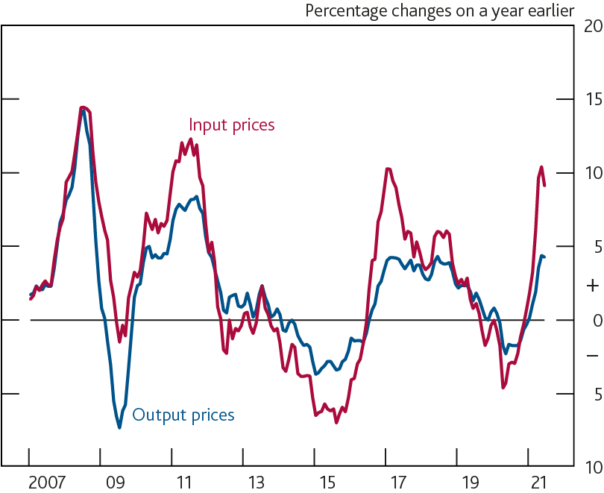
Chart 3.5: Input and output price inflation have both risen for UK manufacturers
Producer prices^{(a)}
Sources: ONS and Bank calculations.
(a) Latest data point is for June 2021.

Slide 7
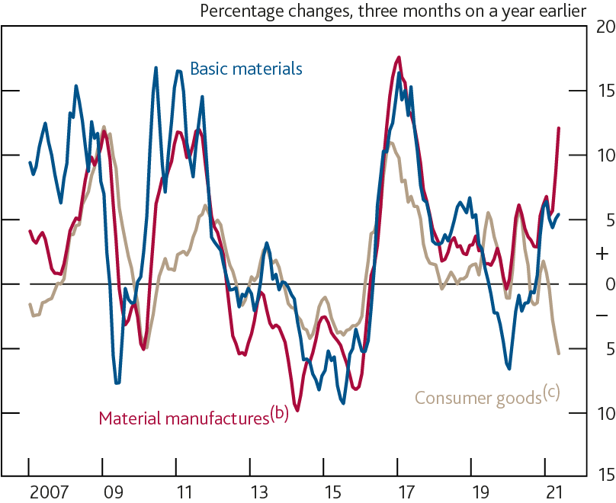
Chart 3.6: The prices of some imported basic materials and manufactured components have increased sharply in recent months
Import prices^{(a)}
Sources: ONS and Bank calculations.
(a) Latest data point is for May 2021.
(b) Excludes erratics.
(c) Excludes cars.

Slide 8
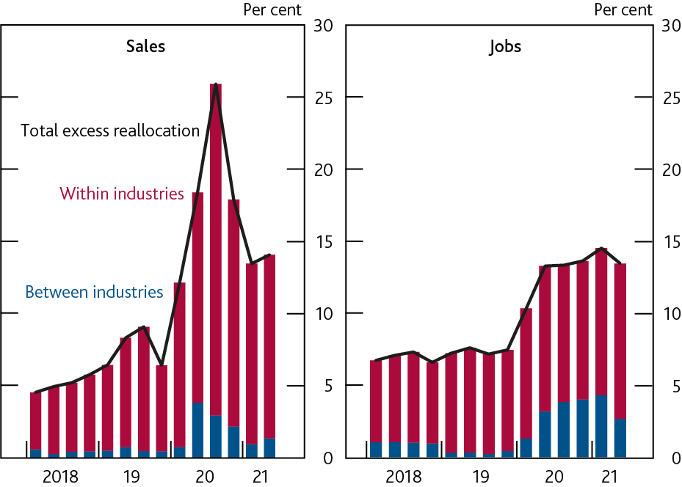
Chart 3.7: Spending patterns have adjusted sharply during the pandemic, but there has been less job reallocation
Three-year sales and employment reallocation^{(a)}
Sources: DMP Survey and Bank calculations.
(a) Excess reallocation is the amount of cross-firm sales and job reallocation in excess of what is required by the aggregate changes in these variables, following a similar method to Barrero et al (2021). These are shown as percentages of total sales and employment respectively. Three-year reallocation estimates are based on realised changes over the prior two years and expected changes over the coming year. Latest data point is for 2021 Q2.

Slide 9
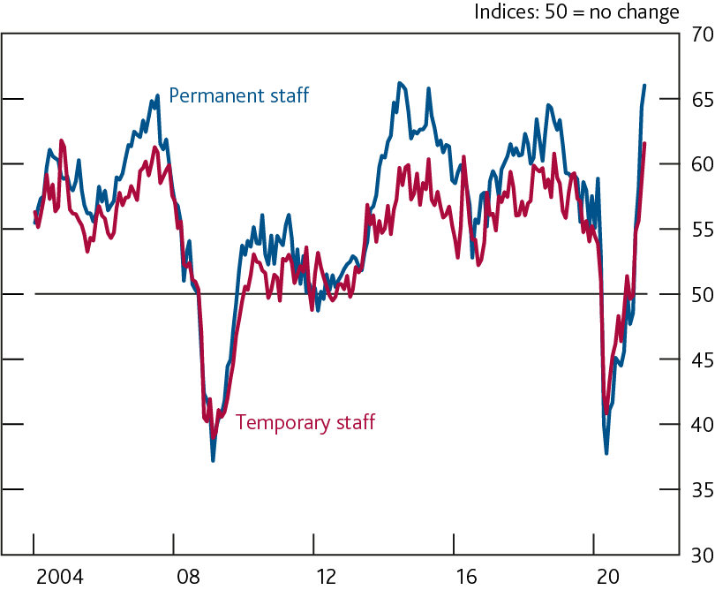
Chart 3.8: Pay rates have risen for new permanent and temporary staff
Pay rates for new staff^{(a)}
Source: KPMG/REC UK Report on Jobs.
(a) Latest data point is for June 2021.

Slide 10
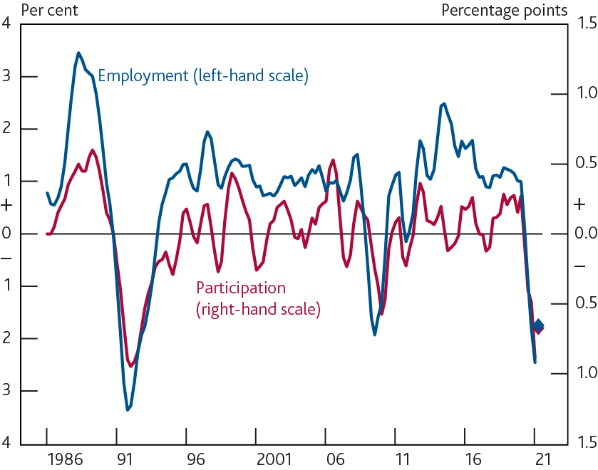
Chart 3.9: The participation rate has fallen, as would be expected given the fall in employment
Annual employment growth and change in participation rate^{(a)}
Sources: ONS and Bank calculations.
(a) Two-quarter moving averages. Diamonds are based on Bank staff projections for 2021 Q2.

Slide 11
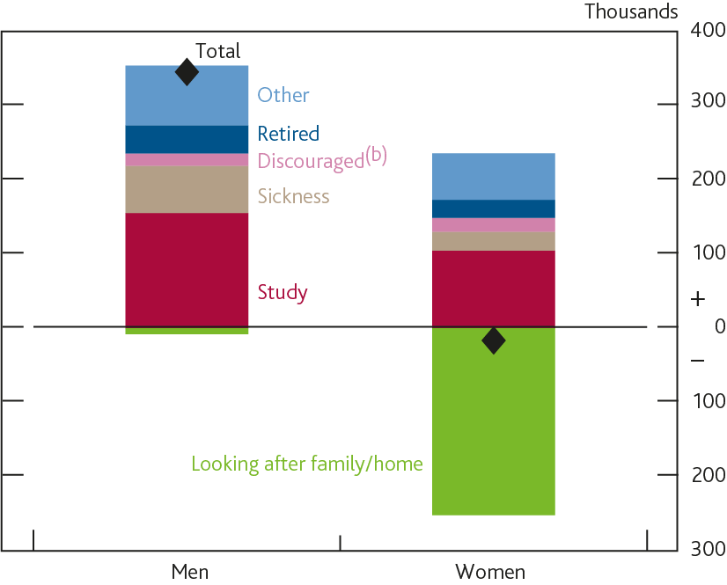
Chart 3.10: The number of people inactive in the labour market due to study has risen
Changes in inactivity since 2019 Q4 by reason^{(a)}
Sources: ONS and Bank calculations.
(a) Changes between the three months to December 2019 and the three months to May 2021, based on those aged 16–64.
(b) Those who are not looking for work because they believe no jobs are available.

Slide 12
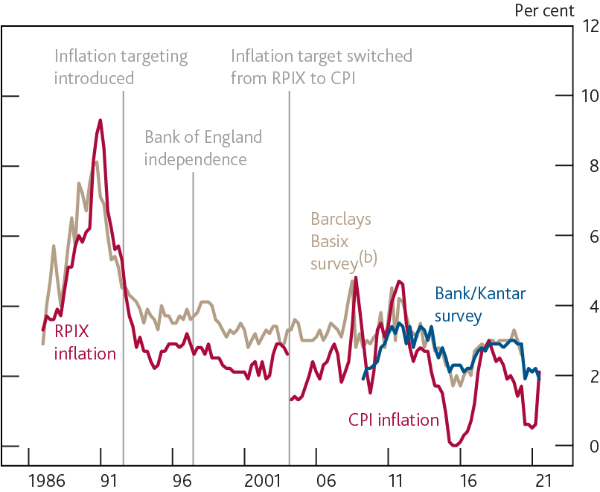
Chart 3.11: Household inflation expectations have been well anchored in the inflation targeting era
Inflation and households’ two year ahead expectations^{(a)}
Sources: Bank of England, Barclays, Kantar and ONS.
(a) In December 2003 the inflation target was changed from 2.5% based on the RPIX measure, to 2% based on the CPI.
(b) The Barclays Basix survey was suspended in 2020.

Slide 13
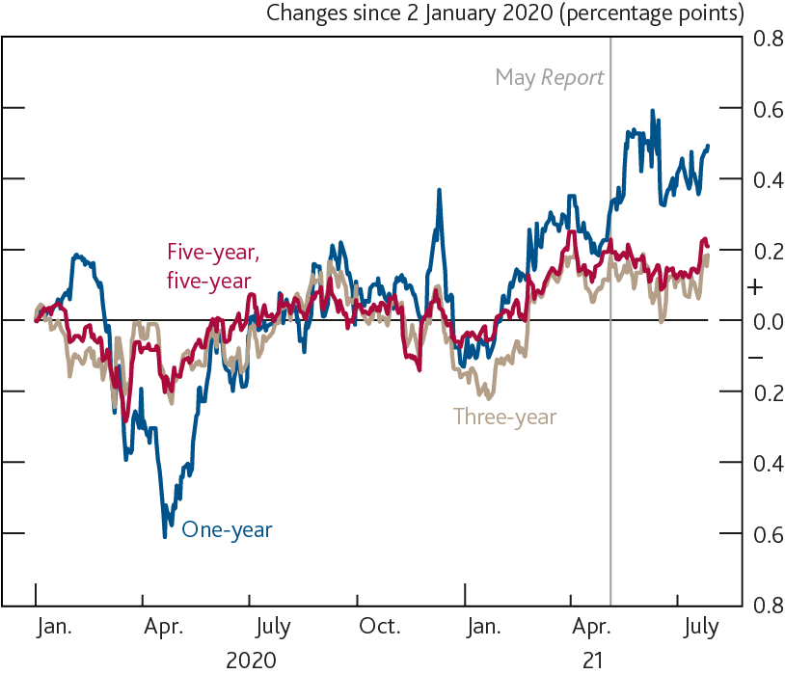
Chart 3.12: Measures of financial markets’ inflation expectations have risen during 2021
Changes in inflation compensation at different horizons^{(a)}
Sources: Bloomberg Finance L.P. and Bank calculations.
(a) Instantaneous RPI inflation one and three years ahead and five-year RPI inflation five years ahead, derived from swaps.

Slide 14
Table 3.A: Inflation expectations remain well anchored
Measures of inflation expectations^{(a)}
Sources: Bank of England, Bloomberg Finance L.P., CBI, Citigroup, Kantar, ONS, YouGov and Bank calculations.
(a) Data are not seasonally adjusted.
(b) Averages from 2000, or start of series, to 2007. Financial market data start in October 2004, YouGov/Citigroup data start in November 2005 and external forecasters’ data start in 2006 Q2.
(c) The household surveys do not reference a specific price index.
(d) CBI data for the distributive trades sector. Based on the expected price change over the coming 12 months and the following 12 months in the markets in which firms compete.
(e) Instantaneous RPI inflation one and three years ahead and five-year RPI inflation five years ahead, derived from swaps.
(f) Bank’s survey of external forecasters, CPI inflation rate three years ahead. See annex for the results of the 2021 Q3 survey.

